Slide 1
Topics
Angular JS Events
Angular Filters

Slide 2
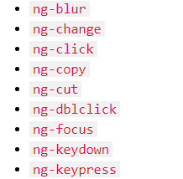
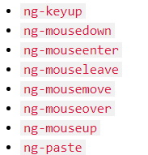
Angular JS Event

Slide 3
Filters
Filters in Angular JS can do 3 different things
  Format data
  Sort data
  Filter data
Filters can be used with binding expression or a directive
To apply a filter use pipe (|) character
  {{expression | filtername : parameter}}

Slide 4
Filters in Angular JS
uppercase | Formats a string to uppercase
lowercase | Formats a string to lowercase
number | Formats a number as text. Includes comma as thousands separator and number of decimal places can be specified.
currency | Formats a number to a currency symbol.
date | Formats a date to a specified format.
orderBy | Orders an array by an expression
json | Formats as objects to a json string
limitTo | Limits an array/string into, a specified number of elements/characters
filter | Select a subset of items from an array.

Slide 5
Angular Date Formats
yyyy | 4 digit year
yy | 2 digit year
MMMM | January - December
MMM | Jan-Dec
MM | 01-12
M | 1-12 (No leading zeroes)
dd | 01-31
d | 1-31 (No leading zeroes)
limitTo filter : Can be used to limit the number of rows in array or characters in a string

Slide 6
Entities
&cent;
&euro;
&commat;
&yen;
&pound;
&reg;
&deg;
&frac15;
&#8377;
&frac34;

Slide 7
Sorting data in Angular JS
To sort the data in Angular
  Use orderBy Filter
  {{orderBy_expr | orderBy :expression : reverse }}
  Eg: <ng-repeat=”emp in employees | orderBy :'salary' : false”/>
  To sort data in ascending order, set reverse to false
  To sort data in descending order, set reverse to true.
  You can also use + and – symbol to sort in ascending / descending
  Eg: <ng-repeat=”emp in employees | orderBy :'+salary' />

Slide 8
Custom Filter
Custom filter in angular JS is a function that returns a function.
Use filter function to create a custom filter.
var myApp = angular.module(“myApp”,[]);
myApp.filter(“filterName”, function(){
  return function(input) {
    //... filter logic goes here..
  }
});

